Slide 1





Defining Classes
Classes, Fields, Constructors, Methods, Properties
Svetlin Nakov
Technical Trainer
www.nakov.com
Telerik Software Academy
Object-Oriented
academy.telerik.com

Slide 2
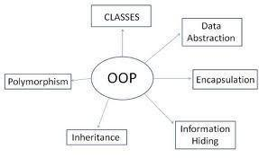

Table of Contents
Defining Simple Classes
Fields
Access Modifiers
Using Classes and Objects
Constructors
Methods
Properties
Enumerations (Enums)
Keeping the Object State

Slide 3
Table of Contents
Static Members
Structures in C#
Namespaces

Slide 4
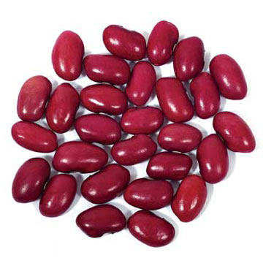
Defining Simple Classes

Slide 5
Classes in OOP
Classes model real-world objects and define
Attributes (state, properties, fields)
Behavior (methods, operations)
Classes describe the structure of objects
Objects describe particular instance of a class
Properties hold information about the modeled object relevant to the problem
Operations implement object behavior

Slide 6
Classes in C#
Classes in C# can have members:
Fields, constants, methods, properties, indexers, events, operators, constructors, destructors, …
Inner types (inner classes, structures, interfaces, delegates, ...)
Members can have access modifiers (scope)
public, private, protected, internal
Members can be
static (common) or specific for a given object

Slide 7
Simple Class Definition
Begin of class definition
public class Cat : Animal {
private string name;
private string owner;
public Cat(string name, string owner)
{
this.name = name;
this.owner = owner;
}
public string Name
{
get { return this.name; }
set { this.name = value; }
}
Inherited (base) class
Fields
Constructor
Property

Slide 8

Simple Class Definition (2)
public string Owner
{
get { return this.owner; }
set { this.owner = value; }
}
public void SayMiau()
{
Console.WriteLine("Miauuuuuuu!");
}
}
Method
End of class definition

Slide 9

Class Definition and Members
Class definition consists of:
Class declaration
Inherited class or implemented interfaces
Fields (static or not)
Constructors (static or not)
Properties (static or not)
Methods (static or not)
Events, inner types, etc.

Slide 10

Fields
Defining and Using Data Fields
Data Fields

Slide 11
Fields
Fields are data members defined inside a class
Fields hold the internal object state
Can be static or per instance
Can be private / public / protected / …
class Dog
{
private string name;
private string breed;
private int age;
protected Color color;
}
Field declarations

Slide 12
Constant Fields
Constant fields are of two types:
Compile-time constants – const
Replaced by their value during the compilation
Runtime constants – readonly
Assigned once only at object creation
class Math
{
public const float PI = 3.14159;
public readonly Color =
Color.FromRGBA(25, 33, 74, 128);
}

Slide 13
Constant Fields – Example
public class Constants
{
public const double PI = 3.1415926535897932385;
public readonly double Size;
public Constants(int size)
{
this.Size = size; // Cannot be further modified!
}
static void Main()
{
Console.WriteLine(Constants.PI);
Constants c = new Constants(5);
Console.WriteLine(c.Size);
c.Size = 10; // Compilation error: readonly field
Console.WriteLine(Constants.Size); // compile error
}
}

Slide 14


Access Modifiers
Public, Private, Protected, Internal

Slide 15
Access Modifiers
Class members can have access modifiers
Used to restrict the classes able to access them
Supports the OOP principle "encapsulation"
Class members can be:
public – accessible from any class
protected – accessible from the class itself and all its descendent classes
private – accessible from the class itself only
internal (default) – accessible from the current assembly, i.e. the current VS project

Slide 16
The 'this' Keyword
The keyword this inside a method points to the current instance of the class
Example:
class Dog
{
private string name;
public void PrintName()
{
Console.WriteLine(this.name);
// The same like Console.WriteLine(name);
}
}

Slide 17

Defining Simple Classes
Example

Slide 18
Task: Define a Class "Dog"
Our task is to define a simple class that represents information about a dog
The dog should have name and breed
Optional fields (could be null)
The class allows to view and modify the name and the breed at any time
The dog should be able to bark
Notes:
Mew = мяукам!

Slide 19

Defining Class Dog – Example
public class Dog {
private string name;
private string breed;
public Dog()
{
}
public Dog(string name, string breed)
{
this.name = name;
this.breed = breed;
}
(the example continues)

Slide 20

Defining Class Dog – Example (2)
public string Name
{
get { return this.name; }
set { this.name = value; }
}
public string Breed
{
get { return this.breed; }
set { this.breed = value; }
}
public void SayBau()
{
Console.WriteLine("{0} said: Bauuuuuu!",
this.name ?? "[unnamed dog]");
}
}

Slide 21

Using Classes and Objects

Slide 22


How to Use Classes (Non-Static)?
Create an instance
Initialize its properties / fields
Manipulate the instance
Read / modify its properties
Invoke methods
Handle events
Release the occupied resources
Performed automatically in most cases

Slide 23
Task: Dog Meeting
Our task is as follows:
Create 3 dogs
The first should be named “Sharo”, the second – “Rex” and the last – left without name
Put all dogs in an array
Iterate through the array elements and ask each dog to bark
Note:
Use the Dog class from the previous example!

Slide 24
Dog Meeting – Example
static void Main()
{
Console.Write("Enter first dog's name: ");
string dogName = Console.ReadLine();
Console.Write("Enter first dog's breed: ");
string dogBreed = Console.ReadLine();
// Use the Dog constructor to assign name and breed
Dog firstDog = new Dog(dogName, dogBreed);
// Use Dog's parameterless constructor
Dog secondDog = new Dog();
// Use properties to assign name and breed
Console.Write("Enter second dog's name: ");
secondDog.Name = Console.ReadLine();
Console.Write("Enter second dog's breed: ");
secondDog.Breed = Console.ReadLine();
(the example continues)

Slide 25
Dog Meeting – Example (2)
// Create a Dog with no name and breed
Dog thirdDog = new Dog();
// Save the dogs in an array
Dog[] dogs = new Dog[] {
firstDog, secondDog, thirdDog };
// Ask each of the dogs to bark
foreach(Dog dog in dogs)
{
dog.SayBau();
}
}

Slide 26

Dog Meeting
Live Demo

Slide 27
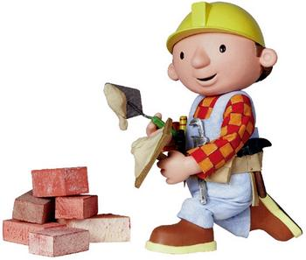
Constructors
Defining and Using Class Constructors

Slide 28
What is Constructor?
Constructors are special methods
Invoked at the time of creating a new instance of an object
Used to initialize the fields of the instance
Constructors has the same name as the class
Have no return type
Can have parameters
Can be private, protected, internal, public

Slide 29

Defining Constructors
Class Point with parameterless constructor:
public class Point
{
private int xCoord;
private int yCoord;
// Simple parameterless constructor
public Point()
{
this.xCoord = 0;
this.yCoord = 0;
}
// More code …
}

Slide 30

Defining Constructors (2)
public class Person
{
private string name;
private int age;
// Parameterless constructor
public Person()
{
this.name = null;
this.age = 0;
}
// Constructor with parameters
public Person(string name, int age)
{
this.name = name;
this.age = age;
}
// More code …
}
As rule constructors should initialize all own class fields.

Slide 31
Constructors and Initialization
Pay attention when using inline initialization!
public class AlarmClock
{
private int hours = 9; // Inline initialization
private int minutes = 0; // Inline initialization
// Parameterless constructor (intentionally left empty)
public AlarmClock()
{ }
// Constructor with parameters
public AlarmClock(int hours, int minutes)
{
this.hours = hours; // Invoked after the inline
this.minutes = minutes; // initialization!
}
// More code …
}

Slide 32

Chaining Constructors Calls
Reusing constructors (chaining)
public class Point
{
private int xCoord;
private int yCoord;
public Point() : this(0, 0) // Reuse the constructor
{
}
public Point(int xCoord, int yCoord)
{
this.xCoord = xCoord;
this.yCoord = yCoord;
}
// More code …
}

Slide 33

Constructors
Live Demo

Slide 34
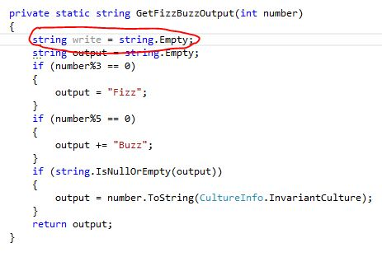


Methods
Defining and Invoking Methods

Slide 35
Methods
Methods are class members that execute some action (some code, some algorithm)
Could be static / per instance
Could be public / private / protected / …
public class Point
{
private int xCoord;
private int yCoord;
public double CalcDistance(Point p)
{
return Math.Sqrt(
(p.xCoord - this.xCoord) * (p.xCoord - this.xCoord) +
(p.yCoord - this.yCoord) * (p.yCoord - this.yCoord));
}
}

Slide 36
Using Methods
Invoking instance methods is done through the object (class instance):
class TestMethods
{
static void Main()
{
Point p1 = new Point(2, 3);
Point p2 = new Point(3, 4);
System.Console.WriteLine(p1.CalcDistance(p2));
}
}

Slide 37
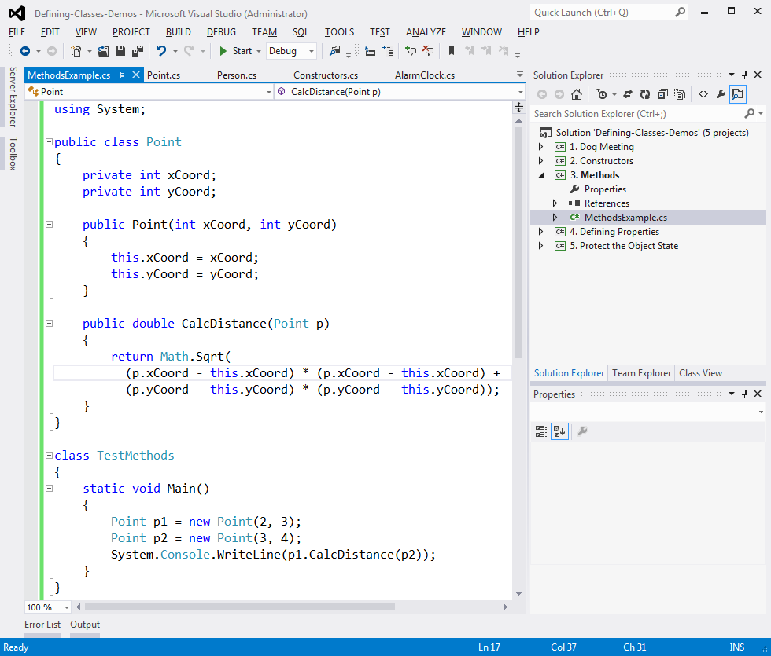
Methods
Live Demo

Slide 38
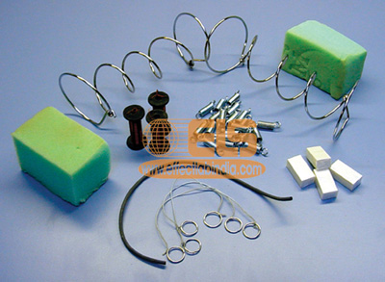
Properties
Defining and Using Properties

Slide 39
The Role of Properties
Properties expose object's data to the world
Control how the data is manipulated
Ensure the internal object state is correct
E.g. price should always be kept positive
Properties can be:
Read-only
Write-only
Read and write
Simplify the writing of code

Slide 40
Defining Properties
Properties work as a pair of methods
Getter and setter
Properties should have:
Access modifier (public, protected, etc.)
Return type
Unique name
Get and / or Set part
Can contain code processing data in specific way, e.g. apply validation

Slide 41
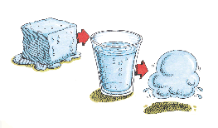
Defining Properties – Example
public class Point
{
private int xCoord;
private int yCoord;
public int XCoord
{
get { return this.xCoord; }
set { this.xCoord = value; }
}
public int YCoord
{
get { return this.yCoord; }
set { this.yCoord = value; }
}
// More code ...
}

Slide 42
Dynamic Properties
Properties are not obligatory bound to a class field – can be calculated dynamically:
public class Rectangle
{
private double width;
private double height;
// More code …
public double Area
{
get
{
return width * height;
}
}
}

Slide 43
Automatic Properties
Properties could be defined without an underlying field behind them
It is automatically created by the compiler
class UserProfile
{
public int UserId { get; set; }
public string FirstName { get; set; }
public string LastName { get; set; }
}
…
UserProfile profile = new UserProfile() {
FirstName = "Steve",
LastName = "Balmer",
UserId = 91112
};

Slide 44

Properties
Live Demo

Slide 45

Enumerations
Defining and Using Enumerated Types

Slide 46
Enumerations in C#
Enumerations are types that hold a value from a fixed set of named constants
Declared by enum keyword in C#
public enum DayOfWeek
{
Mon, Tue, Wed, Thu, Fri, Sat, Sun
}
class EnumExample
{
static void Main()
{
DayOfWeek day = DayOfWeek.Wed;
Console.WriteLine(day); // Wed
}
}

Slide 47
Enumerations – Example
public enum CoffeeSize
{
Small = 100, Normal = 150, Double = 300
}
public class Coffee
{
public CoffeeSize size;
public Coffee(CoffeeSize size)
{
this.size = size;
}
public CoffeeSize Size
{
get { return size; }
}
}
(the example continues)

Slide 48
Enumerations – Example (2)
public class CoffeeMachine
{
static void Main()
{
Coffee normalCoffee = new Coffee(CoffeeSize.Normal);
Coffee doubleCoffee = new Coffee(CoffeeSize.Double);
Console.WriteLine("The {0} coffee is {1} ml.",
normalCoffee.Size, (int)normalCoffee.Size);
// The Normal coffee is 150 ml.
Console.WriteLine("The {0} coffee is {1} ml.",
doubleCoffee.Size, (int)doubleCoffee.Size);
// The Double coffee is 300 ml.
}
}

Slide 49

Enumerations
Live Demo

Slide 50


Keeping the Object State Correct

Slide 51
Keep the Object State Correct
Constructors and properties can keep the object's state correct
This is known as encapsulation in OOP
Can force validation when creating / modifying the object's internal state
Constructors define which properties are mandatory and which are optional
Property setters should validate the new value before saving it in the object field
Invalid values should cause an exception

Slide 52
Keep the Object State – Example
public class Person
{
private string name;
public Person(string name)
{
this.Name = name;
}
public string Name
{
get { return this.name; }
set
{
if (String.IsNullOrEmpty(value))
throw new ArgumentException("Invalid name!");
this.name = value;
}
}
}
We have only one constructor, so we cannot create person without specifying a name.
Incorrect name cannot be assigned

Slide 53

Keeping the Object State Correct
Live Demo

Slide 54

Static Members
Static vs. Instance Members

Slide 55

Static Members
Static members are associated with a type rather than with an instance
Defined with the modifier static
Static can be used for
Fields
Properties
Methods
Events
Constructors

Slide 56
Static vs. Non-Static
Static:
Associated with a type, not with an instance
Non-Static:
The opposite, associated with an instance
Static:
Initialized just before the type is used for the first time
Non-Static:
Initialized when the constructor is called

Slide 57

Static Members – Example
static class SqrtPrecalculated
{
public const int MAX_VALUE = 10000;
// Static field
private static int[] sqrtValues;
// Static constructor
static SqrtPrecalculated()
{
sqrtValues = new int[MAX_VALUE + 1];
for (int i = 0; i < sqrtValues.Length; i++)
{
sqrtValues[i] = (int)Math.Sqrt(i);
}
}
(example continues)

Slide 58

Static Members – Example (2)
// Static method
public static int GetSqrt(int value)
{
return sqrtValues[value];
}
}
class SqrtTest
{
static void Main()
{
Console.WriteLine(
SqrtPrecalculated.GetSqrt(254));
// Result: 15
}
}

Slide 59

Static Members
Live Demo

Slide 60
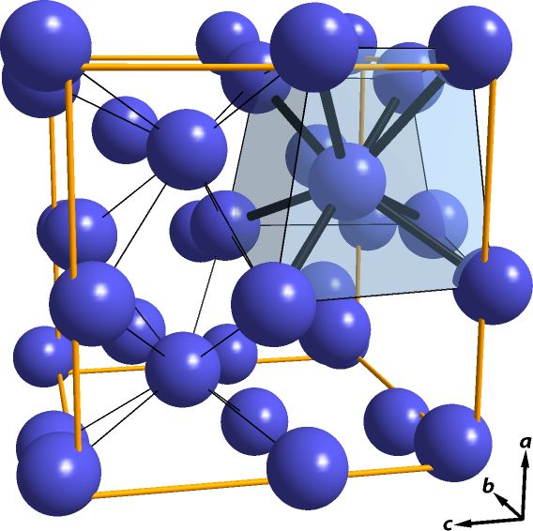
C# Structures

Slide 61
C# Structures
What is a structure in C#?
A value data type (behaves like a primitive type)
Examples of structures: int, double, DateTime
Classes are reference types
Declared by the keyword struct
Structures, like classes, have properties, methods, fields, constructors, events, …
Always have a parameterless constructor
It cannot be removed
Mostly used to store data (bunch of fields)

Slide 62
C# Structures – Example
struct Point
{
public int X { get; set; }
public int Y { get; set; }
}
struct Color
{
public byte RedValue { get; set; }
public byte GreenValue { get; set; }
public byte BlueValue { get; set; }
}
enum Edges { Straight, Rounded }
(example continues)

Slide 63
C# Structures – Example (2)
struct Square
{
public Point Location { get; set; }
public int Size { get; set; }
public Color SurfaceColor { get; set; }
public Color BorderColor { get; set; }
public Edges Edges { get; set; }
public Square(Point location, int size,
Color surfaceColor, Color borderColor,
Edges edges) : this()
{
this.Location = location;
this.Size = size;
this.SurfaceColor = surfaceColor;
this.BorderColor = borderColor;
this.Edges = edges;
}
}

Slide 64
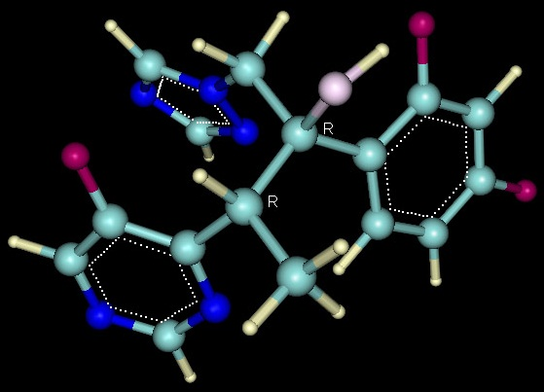

C# Structures
Live Demo

Slide 65


Namespaces

Slide 66
Namespaces
Namespaces logically group type definitions
May contain classes, structures, interfaces, enumerators and other types and namespaces
Can not contain methods and data directly
Can be allocated in one or several files
Namespaces in .NET are similar to namespaces in C++ and packages in Java
Allows definition of types with duplicated names
E.g. a type named Button is found in Windows Forms, in WPF and in ASP.NET Web Forms

Slide 67
Including Namespaces
Including a namespace
The using directive is put at the start of the file
using allows direct use of all types in the namespace
Including is applied to the current file
The directive is written at the begging of the file
When included a namespace with using its subset of namespaces is not included
using System.Windows.Forms;

Slide 68
Including Namespaces (2)
Types, placed in namespaces, can be used and without using directive, by their full name:
using can create alias for namespaces :
System.IO.StreamReader reader =
System.IO.File.OpenText("file.txt");
using IO = System.IO;
using WinForms = System.Windows.Forms;
IO.StreamReader reader =
IO.File.OpenText("file.txt");
WinForms.Form form = new WinForms.Form();

Slide 69
Defining Namespaces
Divide the types in your applications into namespaces
When the types are too much (more than 15-20)
Group the types logically in namespaces according to their purpose
Use nested namespaces when the types are too much
E.g. for Tetris game you may have the following namespaces: Tetris.Core, Tetris.Web, Tetris.Win8, Tetris.HTML5Client

Slide 70
Defining Namespaces (2)
Distribute all public types in files identical with their names
E.g. the class Student should be in the file Student.cs
Arrange the files in directories, corresponding to their namespaces
The directory structure from your project course-code have to reflect the structure of the defined namespaces

Slide 71
Namespaces – Example
namespace SofiaUniversity.Data
{
public struct Faculty
{
// …
}
public class Student
{
// …
}
public class Professor
{
// …
}
public enum Specialty
{
// …
}
}

Slide 72
Namespaces – Example (2)
namespace SofiaUniversity.UI
{
public class StudentAdminForm : System.Windows.Forms.Form
{
// …
}
public class ProfessorAdminForm : System.Windows.Forms.Form
{
// …
}
}
namespace SofiaUniversity
{
public class AdministrationSystem
{
public static void Main()
{
// …
}
}
}

Slide 73
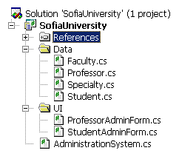
Namespaces – Example (3)
Recommended directory structure and classes organization in them

Slide 74

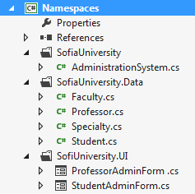
Namespaces
Live Demo

Slide 75
Summary
Classes define specific structure for objects
Objects are particular instances of a class
Classes define fields, methods, constructors, properties and other members
Access modifiers limit the access to class members
Constructors are invoked when creating new class instances and initialize the object's internal state
Enumerations define a fixed set of constants
Properties expose the class data in safe, controlled way

Slide 76



Defining Classes – Part I
Questions?
http://academy.telerik.com

Slide 77
Exercises
Define a class that holds information about a mobile phone device: model, manufacturer, price, owner, battery characteristics (model, hours idle and hours talk) and display characteristics (size and number of colors). Define 3 separate classes (class GSM holding instances of the classes Battery and Display).
Define several constructors for the defined classes that take different sets of arguments (the full information for the class or part of it). Assume that model and manufacturer are mandatory (the others are optional). All unknown data fill with null.
Add an enumeration BatteryType (Li-Ion, NiMH, NiCd, …) and use it as a new field for the batteries.

Slide 78
Exercises (2)
Add a method in the GSM class for displaying all information about it. Try to override ToString().
Use properties to encapsulate the data fields inside the GSM, Battery and Display classes. Ensure all fields hold correct data at any given time.
Add a static field and a property IPhone4S in the GSM class to hold the information about iPhone 4S.

Slide 79
Exercises (3)
Create a class Call to hold a call performed through a GSM. It should contain date, time, dialed phone number and duration (in seconds).
Add a property CallHistory in the GSM class to hold a list of the performed calls. Try to use the system class List<Call>.
Add methods in the GSM class for adding and deleting calls from the calls history. Add a method to clear the call history.
Add a method that calculates the total price of the calls in the call history. Assume the price per minute is fixed and is provided as a parameter.

Slide 80
Exercises (4)
Create a structure Point3D to hold a 3D-coordinate {X, Y, Z} in the Euclidian 3D space. Implement the ToString() to enable printing a 3D point.
Add a private static read-only field to hold the start of the coordinate system – the point O{0, 0, 0}. Add a static property to return the point O.
Write a static class with a static method to calculate the distance between two points in the 3D space.
Create a class Path to hold a sequence of points in the 3D space. Create a static class PathStorage with static methods to save and load paths from a text file. Use a file format of your choice.

Slide 81




Free Trainings @ Telerik Academy
C# Programming @ Telerik Academy
csharpfundamentals.telerik.com
Telerik Software Academy
academy.telerik.com
Telerik Academy @ Facebook
facebook.com/TelerikAcademy
Telerik Software Academy Forums
forums.academy.telerik.com

